Slide 1

Logistic Regression
Matthew Engelhard
Notes:
Hi Everybody
In this lecture, we’re going to be covering the basics of a predictive model that’s likely to be familiar to many of you – logistic regression
We’ll primarily be talking about the model itself – the form of the logistic regression equation
and we’ll start to think about how we can tune (or learn) parameters that are well matched to a specific dataset
We’re going to take a look at two different examples – one is clinical, and may be similar to other examples you’ve seen
The other is much more visual, and will help us later when we start exploring computer vision

Slide 2

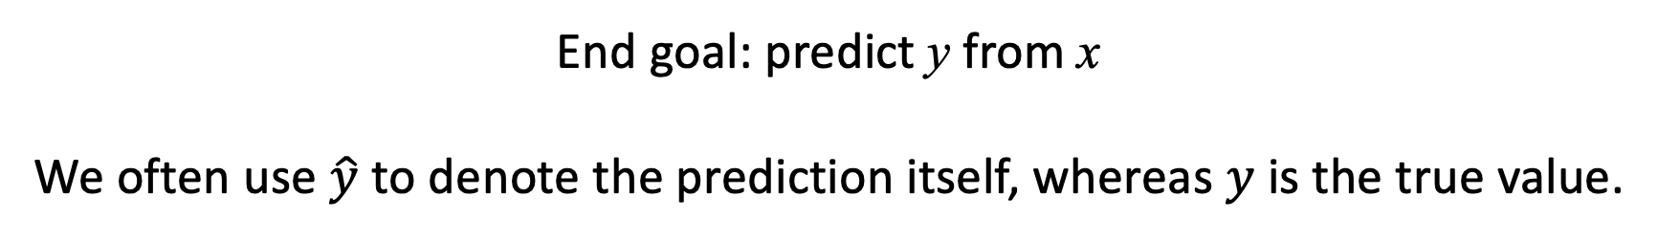

features $x$ -> prediction $y$: a predictive model
y, associated value or label
x, data/features for a subject or patient
End goal: predict y from x
We often use $\hat{y}$ to denote the prediction itself, whereas $y$ is the true value.
Notes:
Recall from last time that a predictive model is a mathematical equation that takes a set of features (x) as its input
And makes a prediction about the value (y) that is associated with (x)
Note that we’ll often use ”y-hat” to denote the prediction made by the model, since the model’s prediction is distinct from the true value of y
Going back to our prostate cancer example from before, the model might predict that the patient has cancer, but that prediction is different from whether they truly do

Slide 3
Simple models often work well for clinical data!
Age
WBC Count
Respiratory Rate
Creatinine
Mean BP
Hematocrit
Pulse Rate
Temperature
Survival
y, associated value or label
x, data/features for a subject or patient
End goal: predict odds of hospital mortality
(APACHE III)
Notes:
Remember, we want to use the simplest model we possibly can
For now I’m asking you to take my word for it, but simple models tend to work quite well for data like this – distinct clinical variables as we have here
So, let’s use the simplest model we can think of – the simplest equation we might consider -- to link all those features (x) to (y), which in this case is whether the patient survived their ICU stay
The fact that y represents survival, which is binary (or yes/no) valued -- will be an important factor as we choose which model is appropriate.

Slide 4
Can we use a linear model?
z_{i}
b₁
b_{M}
$$zi=b_{1}x_{i1}+b_{2}x_{i2}+…+b_{M}x_{iM}$$
x_{i1}
x_{iM}
Notes:
What’s the simplest possible equation? If we set trivial cases aside – ones that don’t actually use the features (x) – then one of the simplest equations we might consider is a linear equation, as shown here
In a linear equation, we get to multiply each feature by a parameter – these are the b values, which will be learned during training – and then we add everything up
In this course, we will use a graph structure like the one you see above to represent this and other equations
Remember that each of these boxes on the bottom is a single numeric value
When we see an arrow going from one box to another, it means that we take the value in the first box – the one where the arrow starts – multiply it by a parameter of the model, which is associated with the edge – here we see that parameter b_1 is associated with that leftmost edge – and we add it to the other box, in this case z_i, where the arrow terminates
So here, the value z_i is obtained by taking the x values, multiplying them by their respective parameters (the values on the edges), and adding up the result
A good question to ask yourself at this point: how many parameters are in this model?
A second good question: is there a problem with this model for the application we’re considering? Survival prediction – prediction of binary outcome
Note that this model, exactly as written, is linear regression
But, linear regression is good for numeric values; in our case, we have an event that may or may not occur, and we’d like to is to predict the probability of event occurrence
As you know, probabilities range from 0 to 1
But there’s nothing stopping z_i from being well outside that range
As a result, what we’ll need is a ”link” function – a function that will ensure that the output of our model is a valid probability rather than an unbounded numeric value
Now, the full mathematical details here – some of the reasoning behind these choices – goes a bit deeper. We’ll return to this in our lectures on model learning.

Slide 5


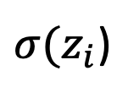
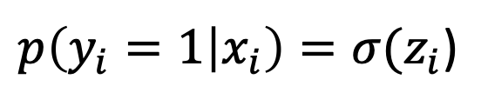

The logistic function converts $z_{i}$ to a probability
$$zi=b_{1}x_{i1}+b_{2}x_{i2}+…+b_{M}x_{iM}+…+b_{0}$$
$p\left(y_{i}=1 | x_{i}\right)=σ(z_{i}$)
Extra Constant
(i.e. intercept)
(i.e. bias)
$σ(z_{i}$)
Notes:
For now, what’s important is that we need a function that will convert any numeric value to a valid probability
For logistic regression, we use the logistic function – often called the sigmoid function, because it is ‘S’ shaped – to perform that conversion.
Here you can see the logistic function – it takes the z_i values, which come from the linear portion of our model and may be found on the x axis of the plot
And it converts them to valid probabilities, as shown on the y axis of the plot
As z_i gets larger, the output of the function gets larger but never exceeds one
As z_i gets smaller, the output gets smaller but never goes below zero
And we can think of this output as the probability of the event y_i – in other words, the probability that y_i has value 1
This is the equation that’s shown on top of the plot
Now, one miscellaneous thing we have to note at this point is that, in addition to the predictors and corresponding coefficients, we do typically include one additional model parameter, called the bias or intercept, that is added to z_i
This parameter is related to the baseline event rate
This equation – z_i is linear in the predictors, and converted to a probability by the logistic function – fully describes the logistic regression model

Slide 6
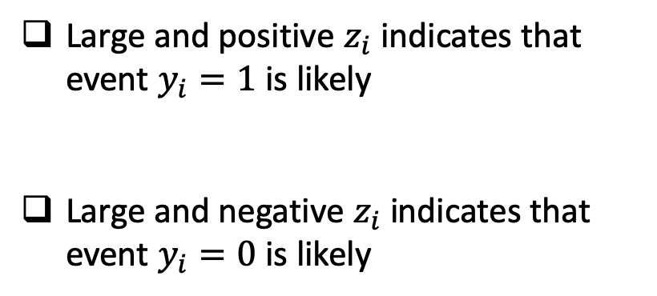
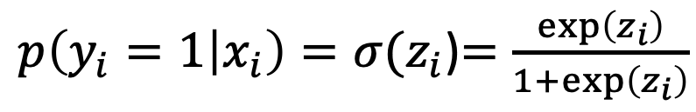
The logistic function converts $z_{i}$ to a probability
$$zi=b_{1}x_{i1}+b_{2}x_{i2}+…+b_{M}x_{iM}+…+b_{0}$$
$p\left(y_{i}=1 | x_{i}\right)=σ(z_{i}$)$=\frac{\exp\left(z_{i}\right)}{1+\exp\left(z_{i}\right)}$
Large and positive $z_{i}$ indicates that event $y_{i}=1$ is likely
Large and negative $z_{i}$ indicates that event $y_{i}=0$ is likely
Notes:
If z_i is large and positive, then the sigmoid will give us a probability that’s close to 1, meaning the event is likely
If z_i is large and negative, then it will give us a probability that’s close to 0, meaning it’s unlikely
If z_i is near 0, then the resulting probability will be near .5, meaning it’s roughly a coin flip
Now, if the output of the sigmoid is a probability, we might ask: is there any intuition around the value of z_i?
It turns out that there is – we can think of z_i as the log-odds of the event y_i
Log-odds values are often called logits
Why do we call this the log odds? Well, if you work it out on a piece of paper, you’ll find that the inverse of the logistic function, which converts the probability of y_i back to the corresponding z_i value, is the log of the ratio between the probability that the event will occur and the probability that it won’t – in other words, the odds. So, for this reason, we can interpret the output of the linear part of our model as ‘log-odds’.

Slide 7
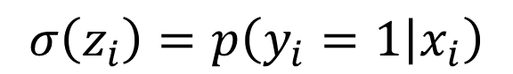

Logistic Regression: a linear model with a logistic “link” function that converts the prediction to a probability
$$σ\left(z_{i}\right)=p\left(y_{i}=1 | x_{i}\right)$$
$$σ$$
z_{i}
b₁
b_{M}
$$p\left(y_{i}=1 | x_{i}\right)=σ(b_{1}x_{i1}+b_{2}x_{i2}+…+b_{M}x_{iM})$$
x_{i1}
x_{iM}
Notes:
So, logistic regression is (1) a linear model, combined with (2) the logistic link function
We want to be able to represent this more compactly, because as we move through the course, our models will be getting more complicated!
We’ll use the circle shown here, with a sigma in the middle, to indicate that the logistic (or sigmoid) function is being applied, in this case to z_i, resulting in a prediction about the probability that y_i is 1, as shown at the top.
Remember that in our ICU example, y_i = 1 corresponds to death, and y_i = 0 corresponds to survival
Note that unlike before, you can no longer see the arrows going to z – this is just to make things a little less messy, and in our slides, the arrows will always move bottom to top – but these arrows are actually important to indicate the direction of information flow within the graph.

Slide 8
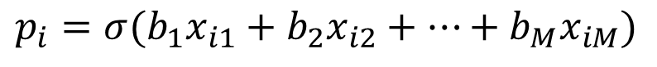
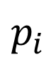
Logistic Regression: a linear model with a logistic “link” function that converts the prediction to a probability
$$p_{i}$$
$$σ$$
z_{i}
b₁
b_{M}
$$p_{i}=σ(b_{1}x_{i1}+b_{2}x_{i2}+…+b_{M}x_{iM})$$
x_{i1}
x_{iM}
Notes:
As one final simplification, we’ll use p_i to denote the probability that y_i is 1 given x_i – p_i is the probability of y_i predicted by our model
And if we placed a threshold on the probability p_i – as we did before in our prostate cancer example – we’d get a predicted value of y_i, which we’ve said is called y_i hat
More on this later.

Slide 9
Logistic Regression
$$p_{i}$$
$$σ$$
Linear
Model
z_{i}
b₁
b_{M}
$$p_{i}=σ(b_{1}x_{i1}+b_{2}x_{i2}+…+b_{M}x_{iM})$$
x_{i1}
x_{iM}
Notes:
So once more – there are two parts to the logistic regression model
First, we have a linear model that relates our features to the log-odds of the event of interest

Slide 10
Logistic Regression
Convert to a
Probability
$$p_{i}$$
$$σ$$
z_{i}
b₁
b_{M}
$$p_{i}=σ(b_{1}x_{i1}+b_{2}x_{i2}+…+b_{M}x_{iM})$$
x_{i1}
x_{iM}
Notes:
Then, we have the logistic link function to convert those predicted log-odds to predicted probabilities.

Slide 11
ICU Mortality Prediction
A clinical example
Notes:
Let’s now continue to dig into logistic regression through two examples.
The first of these will be clinical – let’s return to ICU mortality prediction

Slide 12
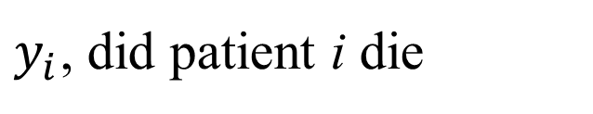
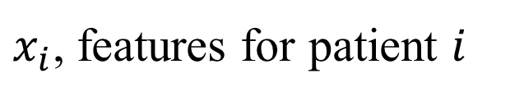
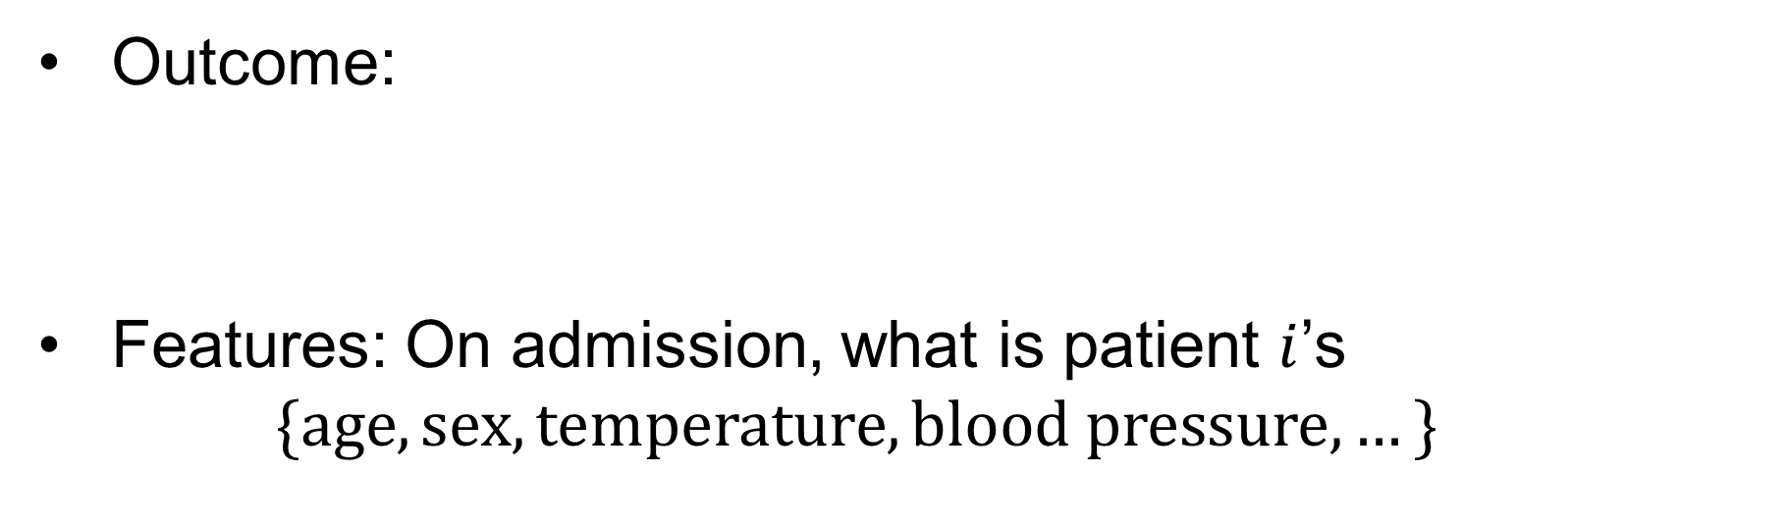
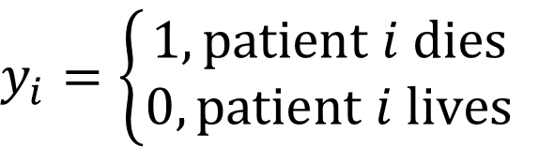
Example: ICU Mortality Prediction
Outcome:
Features: On admission, what is patient $i$’s
$$\{age, sex, temperature,blood pressure,…\}$$
$$y_{i}=\left\{\begin{aligned}1, patient i dies \\ 0, patient i lives\end{aligned}\right.$$
$y_{i}$, did patient i die
$x_{i}$, features for patient $i$
Notes:
For this example, y_i is a binary variable indicating whether the patient survives their ICU stay
And let’s suppose the x_i are a set of demographic variables and physiologic measurements collected at the time of admission
Our goal is to use logistic regression to predict the probability of dying based on the features (x)
We know the general form of the equation, so the question becomes: what parameters are best?

Slide 13
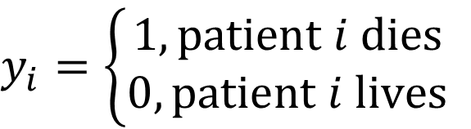
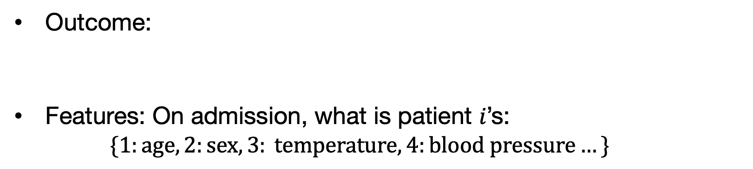
Example: ICU Mortality Prediction
Outcome:
Features: On admission, what is patient 𝑖’s:
$$\{1:age, 2:sex, 3: temperature, 4:blood pressure…\}$$
$$y_{i}=\left\{\begin{aligned}1, patient i dies \\ 0, patient i lives\end{aligned}\right.$$
$$zi=b_{1}x_{i1}+b_{2}x_{i2}+…+b_{M}x_{iM}+b_{0}$$
Age
Blood Pressure
If increased age increases odds of mortality, $b_{1}$ should be positive
Notes:
Let’s think about the parameter b_1 corresponding to our first feature: age
I think it’s reasonable to suppose that older patients, on average, have a higher risk of dying during their ICU stay
If that is the case, then b_1 should be positive
If b_1 is positive, then as age increases, the log-odds z_i will increase, and consequently the probability p_i of mortality will also increase
Now, what about a different feature: blood pressure?
This one’s trickier, because unlike age, low blood pressure and high blood pressure are BOTH associated with increased risk!
So it’s not clear whether the corresponding coefficient should be positive or negative – for this reason, it seems that a linear model might not be very good for capturing the relationship between blood pressure and mortality risk.
We’ll come back to this in the next lecture.

Slide 14
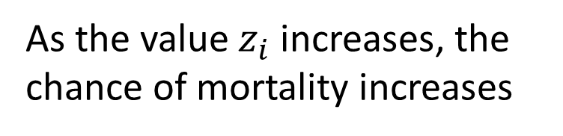
Impact on the Sigmoid Function
$$zi=b_{1}x_{i1}+b_{2}x_{i2}+…+b_{M}x_{iM}+b_{0}$$
$p\left(y_{i}=1 | x_{i}\right)=σ(z_{i}$)
Age
Chance of Rain
As the value $z_{i}$ increases, the chance of mortality increases
Notes:
But going back to age, supposing that b_1 is positive, then an older patient will have a higher z_i value than a younger patient – all else being equal, of course – and thus at higher predicted risk of mortality

Slide 15
The logistic function just converts the patient’s log-odds (of mortality) to the corresponding probability.
An example:
Suppose the patient’s predicted log odds = 2
Convert log odds to odds by exponentiating: e^2 = 7.4
The odds are always relative to 1; in other words, they are 7.4x more likely to die than not
Convert odds to probability = 7.4 / (1 + 7.4) = 0.88
Notes:
Let’s suppose that for that patient, the predicted log-odds is 2.
Let’s take a look at how the sigmoid function converts that log odds to a probability
First, it will exponentiate the log-odds, which converts it to the odds of event occurrence relative to 1.
In other words, this calculation shows that a log-odds of 2 corresponds to the patient being 7.4x more likely to die than not
From these relative odds, we convert to a probability by dividing the relative odds of dying by the total relative odds
Here it may be worth taking a moment to think about relative versus absolute odds and how that relates to the sigmoid function

Slide 16
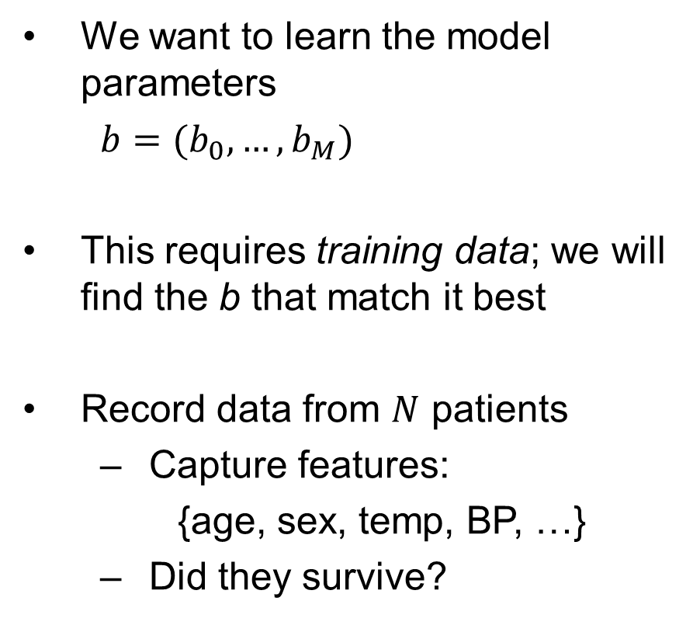
Building the Training Set
We want to learn the model parameters
$b=(b_{0},…,b_{M})$
This requires training data; we will find the b that match it best
Record data from $N$ patients
Capture features:
{age, sex, temp, BP, …}
Did they survive?
x₁
y₁
x₂
y₂
x₃
y₃
x₄
y₄
…
…
x_{N-1}
y_{N-1}
x_{N}
y_{N}
Notes:
Now we’ve been speculating on what the parameters ought to be, but we don’t want to speculate –
We want to learn them from historical data!
So, much like we did for PSA versus prostate cancer, we need to collect all the measurements we’d like to use in our model from a large number of patients admitted to the ICU
Then, we observe the outcome for each of those patients
Our goal – the learning process – the training process – is then to find the parameters b that work best, on average, for predicting connecting x to y in this dataset
We’ll cover the details of the learning process in the next lectures, but the basic idea is this:
We’ll pick a starting value b
Then, we can use calculus to determine how little changes to each of the b values will affect the quality of our predictions
This allows us to change our parameter values a little bit at a time, then reassess
We keep doing this until we find we can no longer make improvements.

Slide 17
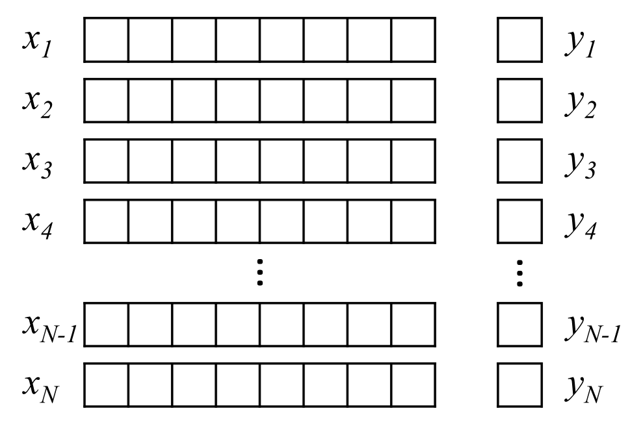
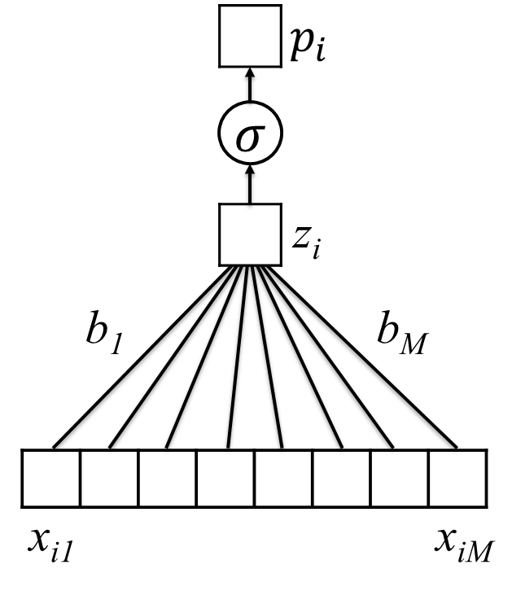
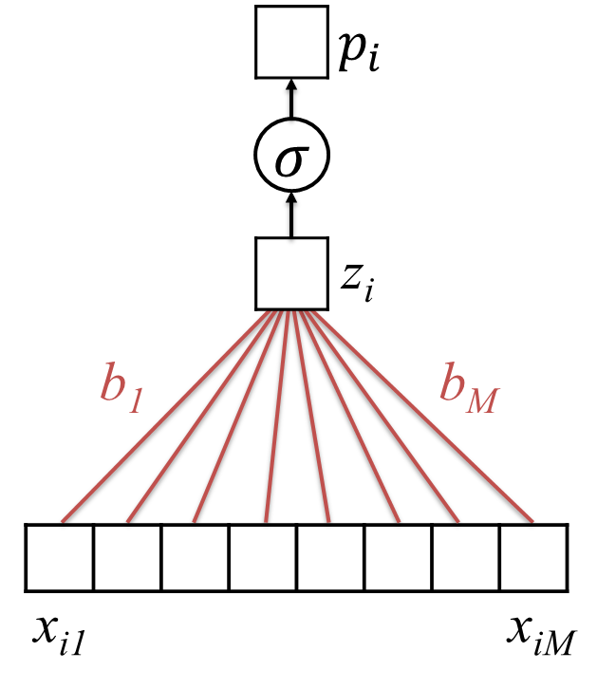
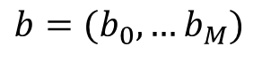
Learning Model Parameters
Training Set
$$p_{i}=σ(b_{0}+b_{1}x_{i1}+b_{2}x_{i2}+…+b_{M}x_{iM})$$
$b=(b_{0},…b_{M})$
Untrained Logistic Regression
Model (or “Network”)
Trained Model (with learned parameters)
Notes:
Those details aside, the big picture is as follows
We collect training data, then choose which type of model we’d like to use
By putting the data together with the model, we can find specific model parameters that are best matched to those data
We can then lock in those parameters – this is our trained model

Slide 18
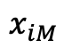
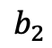

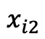
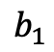


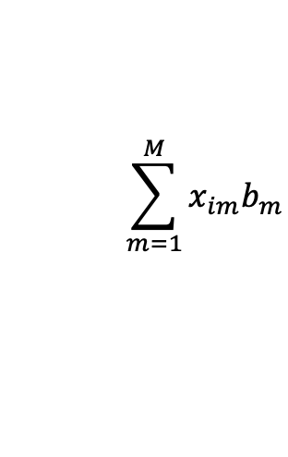
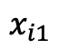
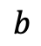
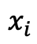




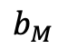
Simplifying our Notation…
$$zi=b_{1}x_{i1}+b_{2}x_{i2}+…+b_{M}x_{iM}$$
$$x_{i1}$$
$$x_{i2}$$
$$…$$
$$…$$
$$x_{iM}$$
$$x_{i}$$
$$\sum_{m=1}^{M}{x_{im}b_{m}}$$
$$×$$
$$×$$
$$…$$
$$…$$
$$×$$
$$b$$
$$b_{1}$$
$$b_{2}$$
$$…$$
$$…$$
$$b_{M}$$
Notes:
OK, at this point it’s time to introduce yet another notational convenience
So far, we’ve been writing out all of the individual features in our feature vector (x)
Each individual feature is multiplied by a corresponding parameter – so, the first element of x_i, x_i1, is multiplied by b_1; x_i2 is multiplied by b_2; and so on; and then they’re all added together
But there’s a simpler way of writing this…
And it’s likely familiar to some of you
This is the dot product – also called an inner product

Slide 19
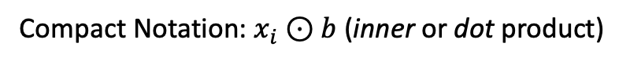
Simplifying our Notation…
$$zi=b_{1}x_{i1}+b_{2}x_{i2}+…+b_{M}x_{iM}$$
$$x_{i1}$$
$$x_{i2}$$
$$…$$
$$…$$
$$x_{iM}$$
$$x_{i}$$
$$\sum_{m=1}^{M}{x_{im}b_{m}}$$
$$×$$
$$×$$
$$…$$
$$…$$
$$×$$
$$b$$
$$b_{1}$$
$$b_{2}$$
$$…$$
$$…$$
$$b_{M}$$
Compact Notation: $x_{i}⊙b$ (inner or dot product)
Notes:
So instead of writing it all out, we can just use this circle with the dot inside
When you see this, you know that each element of x_i is being multiplied by the corresponding element of b, and then they’re all added up

Slide 20
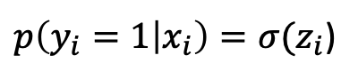

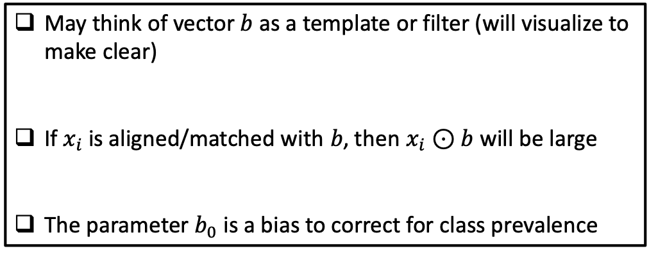
Interpretation of Logistic Regression
$$z_{i}=b_{0}+b_{1}x_{i1}+b_{2}x_{i2}+b_{M}x_{iM}$$
$=b_{0}+x_{i}⊙b$
$p\left(y_{i}=1 | x_{i}\right)=σ(z_{i}$)
May think of vector $b$ as a template or filter (will visualize to make clear)
If $x_{i}$ is aligned/matched with $b$, then $x_{i}⊙b$ will be large
The parameter $b_{0}$ is a bias to correct for class prevalence
Notes:
Now you may remember from math class that the dot product has a nice geometric interpretation
If you take the dot product of x_i and b, the result tells you how far x_i extends in the direction of b – we might say we’re “projecting” x_i on b.
We can make this even more concrete
Because when x_i and b are pointing in the same direction – this is just another way of saying that x_i “looks like” b – that the two are “matched”, or “aligned”.
Consequently, we can think of the parameters b as a filter that is LOOKING for x_i that look like b!
If x_i looks a lot like b – if the two are similar – then the dot product will be large and positive, and the predicted probability will be high
If x_i looks a lot like negative b – if the two are opposite – then the dot product will be large and negative, and the predicted probability will be low
And if x_i doesn’t look much like negative b OR positive b, then the dot product will be small and the predicted probability will be near 0.5

Slide 21
Recognizing Handwritten Digits
A visual example
Notes:
This idea – that the parameters can be viewed as a filter that looks for features that look similar – is central to this next example

Slide 22
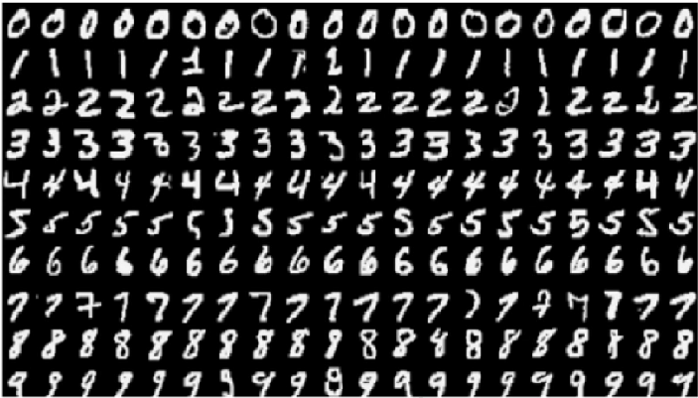
The MNIST Dataset
The Modified National Institute of Standards and Technology (MNIST) contains pictures of handwritten digits (0,1,2,…)
Want to be able to tell what digit each image is (e.g., optical character recognition)
Notes:
We’ll end this lecture by taking a look at how logistic regression is surprisingly effective for solving a difficult problem: recognizing handwritten digits.
We know that this is a solved problem in 2021 – the ATM can read the numbers on your checks no matter how terrible the handwriting – but until fairly recently it was considered quite challenging.
Here we have a few examples of handwritten digits contained in the MNIST dataset
The goal: take an image of a handwritten digit and predict which digit it represents
If the digit is a 0, your model should predict 0 – and so on.

Slide 23
Images are Encoded as Numbers
Notes:
Now, the features of our model have to be numbers – after all, multiplying them by the model parameters doesn’t make sense otherwise
But, it’s straightforward to convert pixels to numbers. The brighter the pixel, the higher the number.
And in fact it’s similar for color images – we just have 3 channels, namely red, green, and blue.
Here we can see how this picture, which we know is an 8 but our model won’t, at least to start – can be converted to a grid of numeric values

Slide 24
Vectorization
We will start talking about deep learning without using the structure of the image
Later, in block 2, we will consider how to take advantage of this structure
To convert an image into an unstructured set of numbers, we vectorize (or flatten) it
vectorization
Notes:
To apply our logistic regression model, however, one additional step is required: we have to flatten the grid to a vector
After going through these two steps, our image of a handwritten 8 now looks like the vectors x_i we’ve considered in our earlier examples
But, important information is lost! When doing this, we are forfeiting information about the 3d orientation of pixels that may be important. In later lectures, we’ll discuss how convolutional neural networks have been designed to overcome this limitation

Slide 25
Start With The Binary Case
Zeros
Ones
Notes:
To keep things simple and consistent, let’s not worry about all 10 digits – we’ll focus on zeros and ones, so that we have a binary prediction problem similar to our mortality prediction example

Slide 26
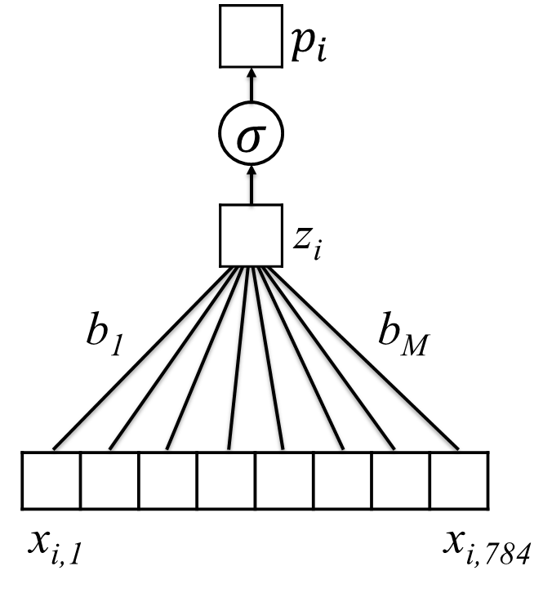
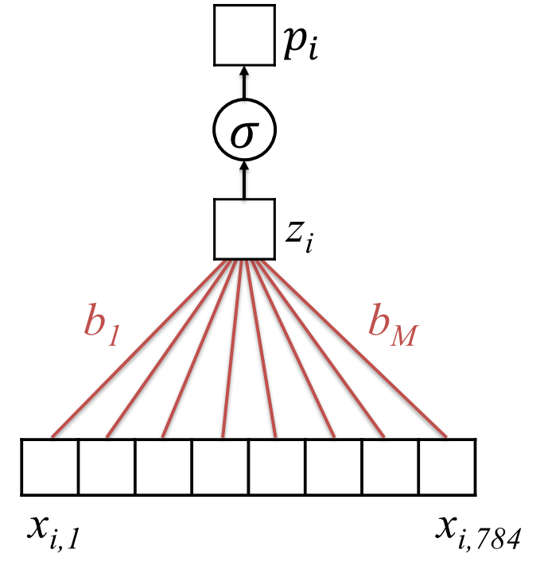
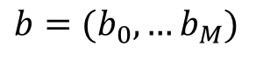
Learning on MNIST
Vectorize
Training set:
28 x 28 images
$$p_{i}=σ(b_{0}+b_{1}x_{i1}+b_{2}x_{i2}+…+b_{M}x_{iM})$$
$b=(b_{0},…b_{M})$
Untrained Logistic Regression
Model (or “Network”)
Trained Model (with learned parameters)
Notes:
Our goal, then, is just like before:
We’ve decided to use logistic regression, and thanks to MNIST, we have a large set of examples of x y pairs
When we put these two together – the untrained model and the training dataset – we can identify the specific set of parameters that best match that dataset, which gives us a trained model that we can use to make our own check-reading ATM.

Slide 27

Zooming in on 0/1
$$σ\left( \right)$$
$$⊙$$
Notes:
And we can represent the parameters of that trained model as a filter, as visualized on the right.
Here we’ve “unvectorized” – we’ve put each parameter in the position of the pixel to which it corresponds
Some of our parameters are positive – positive parameters are indicated here in red
Others are negative – these are indicated with blue
And still others, particularly around the edges of the image, are 0
Again, we can view these parameters as a filter, one that will give us a positive result when applied to an image that looks like the filter, and a negative result when applied to an image that is its opposite
We can see how much the two match by placing the image on top of the filter

Slide 28

Zooming in on 0/1
Negative Sections
$$σ\left( \right)=0.006$$
Notes:
When we place the image of the zero on top of the filter, we see that the positive pixels within the image – these are the bright parts – line up with the negative elements of the filter.
In other words, this image is the OPPOSITE of the filter, and as a result, we get a negative log-odds value – which corresponds to a low probability that the image represents a 1.

Slide 29

Zooming in on 0/1
Positive Section
$$σ\left( \right)=.991$$
Notes:
When we place the image of the one on top of the filter, on the other hand, we see that the positive pixels within the image – again, the bright parts – this time they line up with the positive elements of the filter.
So this time, the image is MATCHED to the filter, and as a result, we get a positive log-odds value, and a high probability that the image represents a 1.
This concept will be important in future lectures, and I recommend trying out a few dot products on paper to reinforce the idea that the dot product of two vectors is larger when the vectors are aligned.

Slide 30
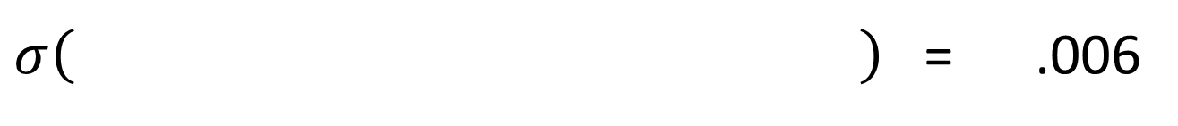


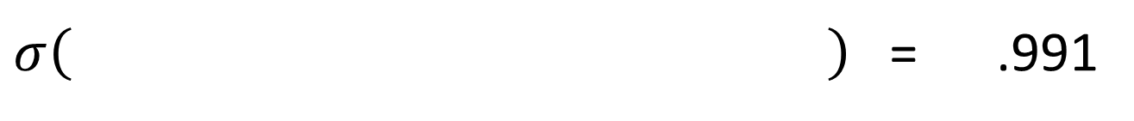
Learned Weights for 0/1
We think that this is a “zero” (.6% chance it is a “one”)
$σ\left( \right)$ = .006
$$⊙$$
We think that this is a “one” (99.1% chance it is a “one”)
$σ\left( \right)$ = .991
$$⊙$$
Notes:
As mentioned initially, this approach performs surprisingly well – in fact, the filter pictured here gives us over 90% accuracy when distinguishing handwritten zeros from handwritten ones.

Slide 31
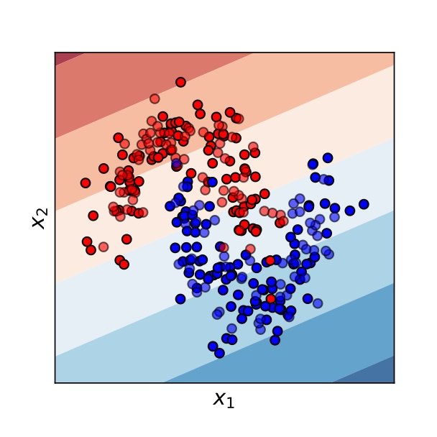
Logistic Regression is a “Linear” Classifier
A “generalized linear model”
Can only split data by linear trends
Notes:
However – and importantly – logistic regression does have an important limitation: it is a linear model! While this can be advantageous in some settings, and for purposes of interpretability, it does mean that the model can split data only by linear trends.
This fact can be understood in terms of the dot product: all that matters to the model is how far the feature vector extends in the direction of the parameter vector (i.e. filter)
The image on the right shows just how limiting this assumption can be.
Looking at the image, it would be straightforward for you or I to draw a curved boundary that separates the blue points from the red points quite well.
But logistic regression can’t: again, it can only draw a linear boundary.
As a result, any logistic regression model will, necessarily, misclassify a substantial number of these points
And while this might seem unimportant when considering the points in the abstract, let’s imagine that the red points are individuals who have cancer, and the blue points are individuals who don’t. In many real applications, logistic regression performs quite well. But there are many other cases where it’s critical that we use a more flexible model.
This will be the topic of our next lecture.

Slide 32
Summary
Logistic regression is commonly used in machine learning to predict events and/or binary labels. It is simple but often quite effective.
Logistic regression consists of a linear model coupled with a logistic “link” function that converts predictions to valid probabilities.
We may view its parameters as a filter; when the features and filter are similar (dissimilar), the predicted probability is high (low).
For many problems, however, we will not want to limit ourselves to a linear decision surface. In the next lecture, we will extend logistic regression to address this limitation.

